Slide 1
Test-taking Strategies &
Mock Midterm
Test-taking Strategies, Midterm Practice Exam, Practice Exam Walkthrough and Rubric
Notes:
Go over mistake in midterm practice problem solutions
Go over double checking GitLab tag and commit

Slide 2
Lecture Outline
Test-taking Strategies
  Maximizing Success on Exam Day
Midterm Practice Exam
  Mock Exam, Debrief, and Reflection
Practice Exam Solutions and Rubric
  Walkthrough of Solutions and Exploring Sample Rubrics

Slide 3
Test-taking Strategies Discussion
What are some test-taking strategies you have previously utilized in taking your exams?
Were those test-taking strategies effective for you? Why or why not?
Which test-taking strategies might you try implementing on the CSE 390B midterm or any other upcoming exam?

Slide 4
Test-taking Strategies
Survey the entire exam before beginning
  Helps plan how much time to allocate for each problem
Read exam directions and question statements carefully
  Use highlights, underlines, circles on important details
Answer the questions you feel the most confident in first
If stuck on a problem, make a mark on the problem and revisit the question later

Slide 5
Test-taking Strategies
Prioritize how you will answer questions
  Do this based on confidence level for each type of question or how long you think each will take
Rely on a methodological approach for each question
  Helps make taking the test feel more systematic
If stuck on a question, demonstrate what you know
  Many exam questions reward partial credit
If time allows, double check your answers
  Catches any small mistakes that may have been made earlier

Slide 6
Lecture Outline
Test-taking Strategies
  Maximizing Success on Exam Day
Midterm Practice Exam
  Mock Exam, Debrief, and Reflection
Practice Exam Solutions and Rubric
  Walkthrough of Solutions and Exploring Sample Rubrics

Slide 7
Midterm Practice Exam
The exam is closed-note, closed-book
  You may only use the midterm reference sheet
Questions are not necessarily in order of difficulty
You will have 30 minutes to complete the mock exam
  We will give you a 5-minute warning
Remember to relax and take deep breaths

Slide 8
Test-Taking Self-Assessment
Reflect on which test-taking strategies you utilized:
  When you received the exam
  As you were answering the questions
  When you got stuck
  When wrapping up the exam
What did you learn about yourself through this process? About your test-taking practices?

Slide 9
Lecture Outline
Test-taking Strategies
  Maximizing Success on Exam Day
Midterm Practice Exam
  Mock Exam, Debrief, and Reflection
Practice Exam Solutions and Rubric
  Walkthrough of Solutions and Exploring Sample Rubrics

Slide 10
Question 1: Circuit Design
Part a: Truth Table
A_{t} | B_{t} | A_{t+1} | B_{t+1}
1 | 1 | 1 | 0
1 | 0 | 0 | 1
0 | 1 | 0 | 0
0 | 0 | 1 | 1
11 → 10 → 01 → 00 → 11

Slide 11
Question 1: Circuit Design
Part a: Truth Table
A_{t} | B_{t} | A_{t+1} | B_{t+1}
1 | 1 | 1 | 0
1 | 0 | 0 | 1
0 | 1 | 0 | 0
0 | 0 | 1 | 1
11 → 10 → 01 → 00 → 11

Slide 12
Question 1: Circuit Design
Part a: Truth Table
A_{t} | B_{t} | A_{t+1} | B_{t+1}
1 | 1 | 1 | 0
1 | 0 | 0 | 1
0 | 1 | 0 | 0
0 | 0 | 1 | 1
A_{t+1} = (A_{t} & B_{t})
A_{t+1} = (~A_{t} & ~B_{t})
Part b: Boolean Expressions

Slide 13
Question 1: Circuit Design
Part a: Truth Table
A_{t} | B_{t} | A_{t+1} | B_{t+1}
1 | 1 | 1 | 0
1 | 0 | 0 | 1
0 | 1 | 0 | 0
0 | 0 | 1 | 1
A_{t+1} = (A_{t} & B_{t})
A_{t+1} = (~A_{t} & ~B_{t})
Part b: Boolean Expressions
A_{t+1} = (A_{t} & B_{t}) | (~A_{t} & ~B_{t})

Slide 14
Question 1: Circuit Design
Part a: Truth Table
A_{t} | B_{t} | A_{t+1} | B_{t+1}
1 | 1 | 1 | 0
1 | 0 | 0 | 1
0 | 1 | 0 | 0
0 | 0 | 1 | 1
A_{t+1} = (A_{t} & B_{t})
B_{t+1} = (A_{t} & ~B_{t})
A_{t+1} = (~A_{t} & ~B_{t})
B_{t+1} = (~A_{t} & ~B_{t})
Part b: Boolean Expressions
A_{t+1} = (A_{t} & B_{t}) | (~A_{t} & ~B_{t})
B_{t+1} = (A_{t} & ~B_{t}) | (~A_{t} & ~B_{t})
= ~B_{t} & (A_{t} | ~ A_{t}) [Factor out ~B_{t}]
= ~B_{t} [A_{t} | ~ A_{t} = 1]

Slide 15
Question 1: Circuit Design
Part a: Truth Table
Part c: Drawing the Circuit
A_{t} | B_{t} | A_{t+1} | B_{t+1}
1 | 1 | 1 | 0
1 | 0 | 0 | 1
0 | 1 | 0 | 0
0 | 0 | 1 | 1
Part b: Boolean Expressions
A_{t+1} = (A_{t} & B_{t}) | (~A_{t} & ~B_{t})
B_{t+1} = (A_{t} & ~B_{t}) | (~A_{t} & ~B_{t})
= ~B_{t} & (A_{t} | ~ A_{t}) [Factor out ~B_{t}]
= ~B_{t} [A_{t} | ~ A_{t} = 1]

Slide 16
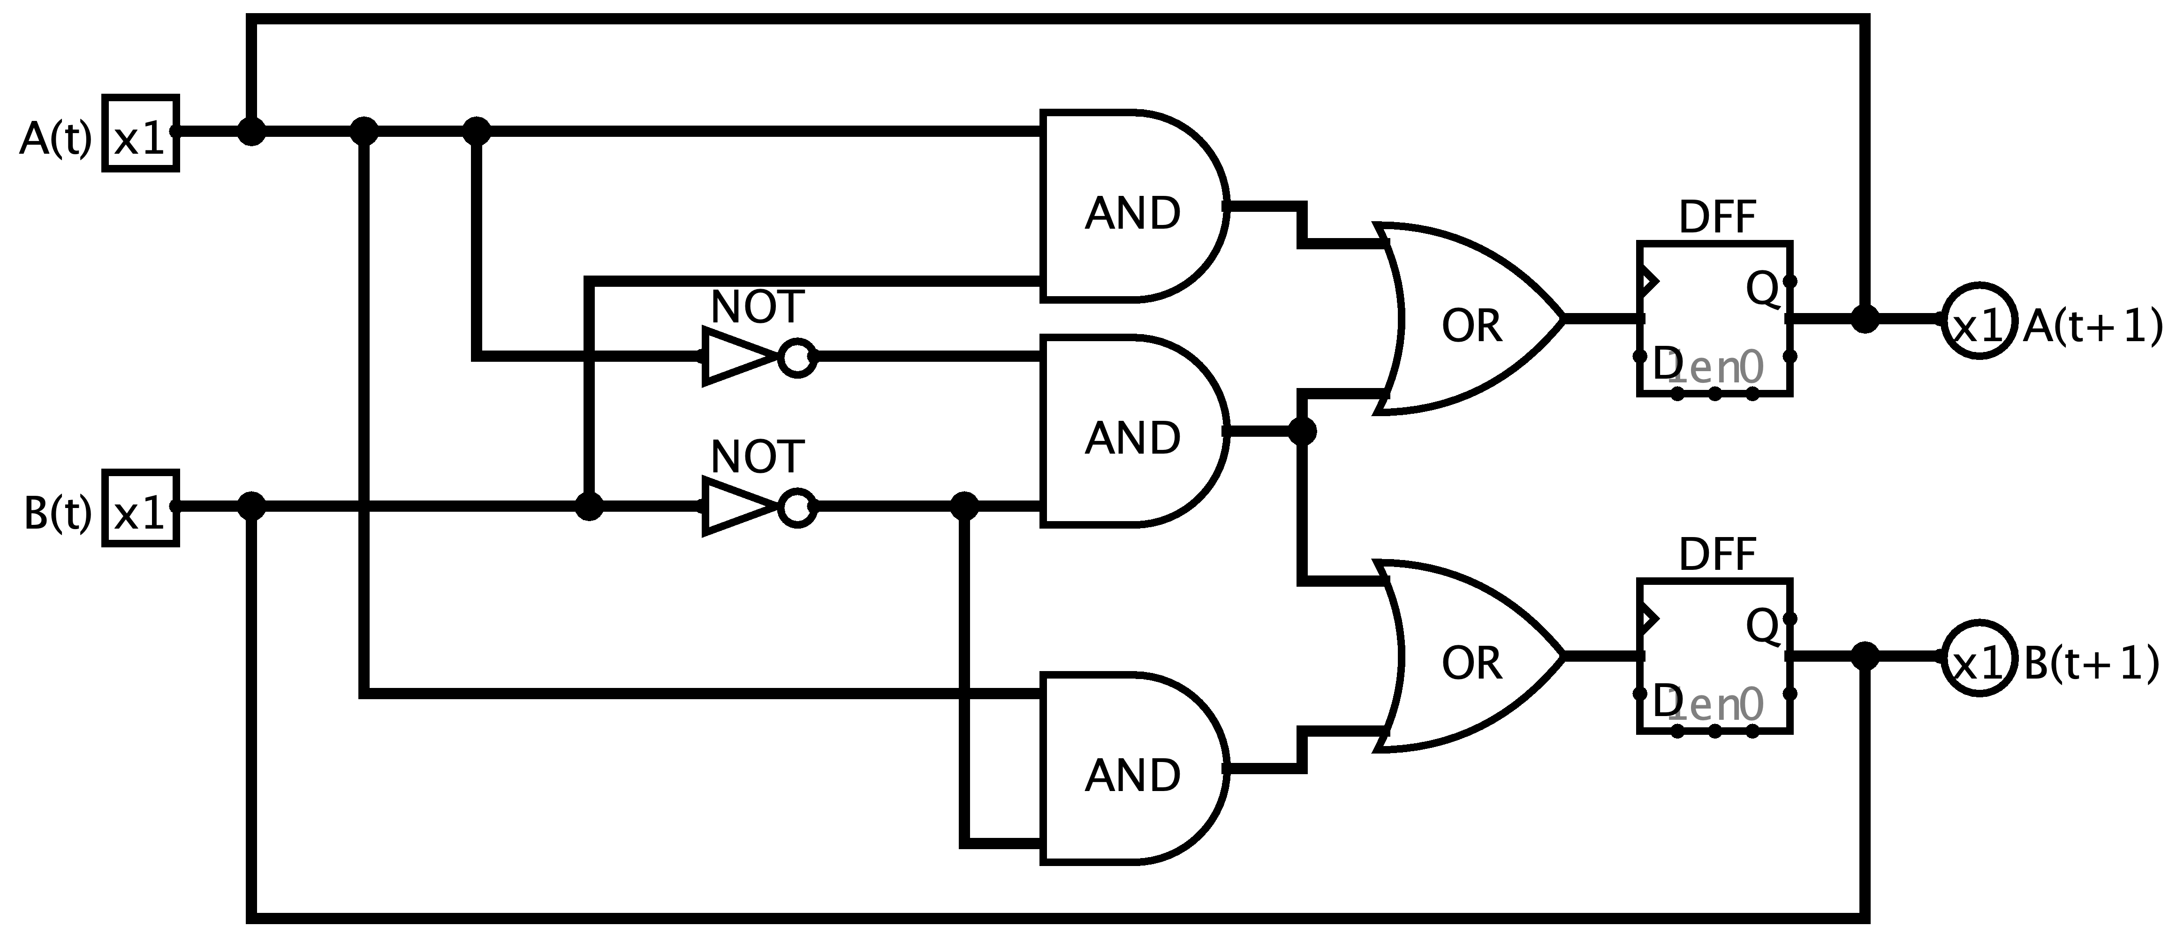
Question 1: Circuit Design
Part a: Truth Table
Part c: Drawing the Circuit
A_{t} | B_{t} | A_{t+1} | B_{t+1}
1 | 1 | 1 | 0
1 | 0 | 0 | 1
0 | 1 | 0 | 0
0 | 0 | 1 | 1
Part b: Boolean Expressions
A_{t+1} = (A_{t} & B_{t}) | (~A_{t} & ~B_{t})
B_{t+1} = (A_{t} & ~B_{t}) | (~A_{t} & ~B_{t})
= ~B_{t} & (A_{t} | ~ A_{t}) [Factor out ~B_{t}]
= ~B_{t} [A_{t} | ~ A_{t} = 1]

Slide 17
Question 1: Circuit Design Sample Rubric
Category | Points | Criteria
Truth Table | 4 points | 1 point for each row in the truth table that is correct
Boolean Expressions | 6 points | 4 points for correct expression for A_{t+1} 2 points if truth table is wrong but expression matches truth table 2 points for correct expression for B_{t+1} 1 point if truth table is wrong but expression matches truth table
Circuit Diagram | 5 points | 3 points for having circuits that match the Boolean expressions in part b 2 points for fully correct diagram
Total | 15 points

Slide 18
Question 2: Math Puzzle
Dana needs 300 pickets for her colorful picket fence. She wants equal amounts of each of her 4 selected colors. She already has 32 red, 26 green, 9 yellow, and no blue. If the pickets cost 25 cents and you get 20% off if you purchase 50 or more of the same color, and 30% off if you purchase 60 or more of one color, how much does Dana need to spend? List your answer to two decimal places. You may use a calculator application on your computer to solve this problem.

Slide 19
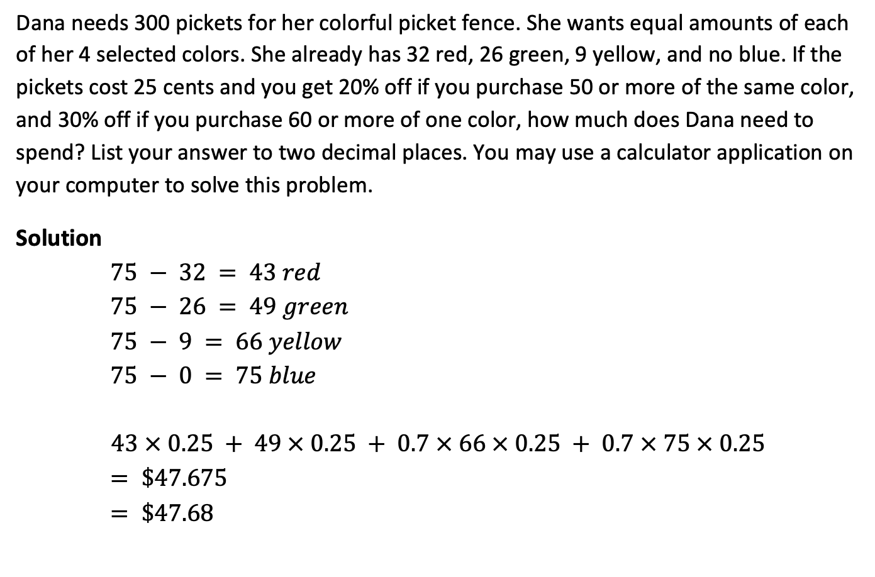
Question 2: Math Puzzle
Dana needs 300 pickets for her colorful picket fence. She wants equal amounts of each of her 4 selected colors. She already has 32 red, 26 green, 9 yellow, and no blue. If the pickets cost 25 cents and you get 20% off if you purchase 50 or more of the same color, and 30% off if you purchase 60 or more of one color, how much does Dana need to spend? List your answer to two decimal places. You may use a calculator application on your computer to solve this problem.
Solution
$75 − 32 = 43 red$
$75 − 26 = 49 green$
$75 − 9 = 66 yellow$
$75 − 0 = 75 blue$
$$43 × 0.25 + 49 × 0.25 + 0.7 × 66 × 0.25 + 0.7 × 75 × 0.25$$
$= \$47.675$
$= \$47.68$
(Rounding down is also acceptable)

Slide 20
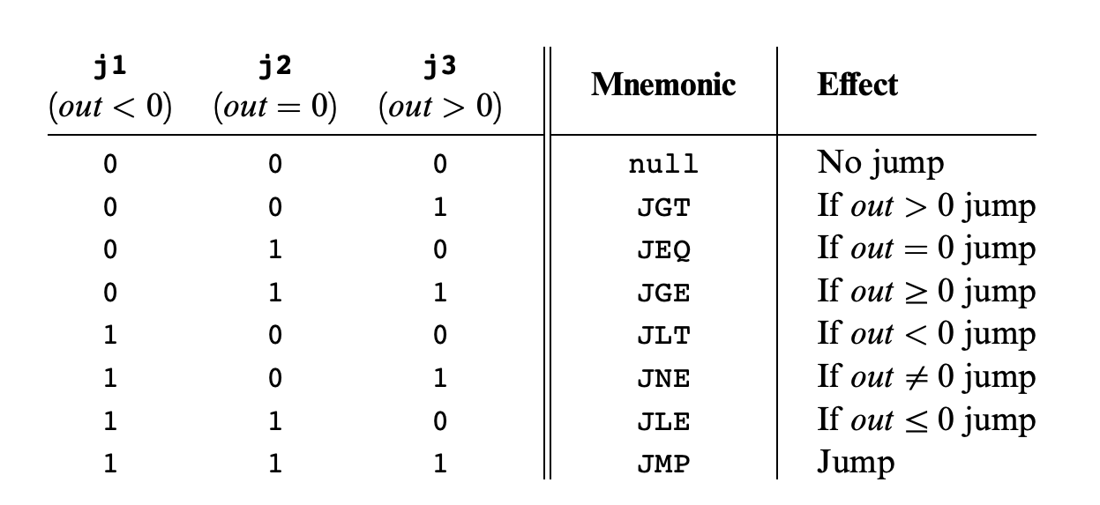
Question 3: Hack Assembly Programming
Write a Hack assembly program that stores -1, 0, or 1 in R1 based on the sign of R0. To be more specific, your program should store a -1 in R1 if R0 is negative, a 0 in R1 if R0 is 0, and a 1 in R1 if R0 is positive.

Slide 21
Question 3: Hack Assembly Programming
Write a Hack assembly program that stores -1, 0, or 1 in R1 based on the sign of R0. To be more specific, your program should store a -1 in R1 if R0 is negative, a 0 in R1 if R0 is 0, and a 1 in R1 if R0 is positive.
Equivalent pseudocode:
if (R0 < 0){
R1 = -1;
} else if (R0 > 0){
R1 = 1;
} else { //R0 == 0
R1 = 0;
}

Slide 22
Question 3: Hack Assembly Programming
One solution:
@R0
D = M
@NEGATIVE
D; JLT
@POSITIVE
D; JGT
// R0 == 0 case
@R1
M = 0
@END
0; JMP
(NEGATIVE)
// R0 < 0 case
@R1
M = -1
@END
0; JMP
(POSITIVE)
// R0 > 0 case
@R1
M = 1
(END)
@END
0; JMP
Write a Hack assembly program that stores -1, 0, or 1 in R1 based on the sign of R0. To be more specific, your program should store a -1 in R1 if R0 is negative, a 0 in R1 if R0 is 0, and a 1 in R1 if R0 is positive.
Equivalent pseudocode:
if (R0 < 0){
R1 = -1;
} else if (R0 > 0){
R1 = 1;
} else { //R0 == 0
R1 = 0;
}

Slide 23
Question 3: Hack Assembly Sample Rubric
Category | Points | Criteria
Has Infinite End Loop | 1 point | 1 point if program has an Infinite End Loop
Conditional Checks | 4 points | 2 points for having at least two checks for cases. Almost all solutions will need a check for 2 of the three cases (negative, zero, positive). 2 points for correctly matching jump condition to cases (e.g. jump to negative case when negative, etc.)
Assigns Correct R1 Value | 3 points | One point for each case: negative: R1 = -1 zero: R1 = 0 positive: R1 = 1
Fully Correct Implementation | 2 points | Covers any little mistakes that may result in an incorrect implementation (e.g., forgetting to jump to the end when a case is done)
Total | 10 points

Slide 24
Question 4: Metacognitive Skills
Name two metacognitive skills that we have covered in CSE 390B so far.

Slide 25
Post-Lecture 11 Reminders
CSE 390B midterm this Thursday (5/4) during lecture at 2:30pm
Project 6 (Mock Exam Problem & Building a Computer) due next Thursday (5/11) at 11:59pm
Preston has office hours after class in CSE2 121
  Feel free to post your questions on the Ed board as well

